Slide 1
Welcome
Esperanza Vielma
Executive Director
espe@ejc4w.org

Slide 2
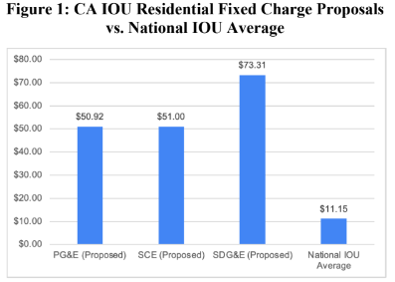
Residential Fixed Charges – Comparisons of California IOU Proposals
Developed By: EQ Research LLC
Date: April 11, 2023
https://eq-research.com/wp-content/uploads/2023/04/20230411-Residential-Fixed-Charges.pdf

Slide 3
small single family detached home, apartments, duplexes, townhomes, and condominiums
BILL RATE INCREASE 10 – 20%
1250 ft2 home
BILL RATE DECREASE 15– 30%
large 3750 ft2 home
Preliminary Assessment of Fixed Charge Proposals
Flagstaff Research

Slide 4
Thank you
https://ejcw.org/
https://ceeetruth.org/
Contact
espe@ejc4w.org

